Slide 1
Machine Learning Workshop Development
Mentor: Arielle Blum
Student: Xucheng You
Notes:
Hi everyone, I am Xucheng You and my DLA supervisor is Arielle Blum

Slide 2
Introduction
Developing Machine Learning workshop for absolute beginners:
Bring up students’ interests in Machine Learning
Introduce basic concept and algorithm without involving much math
Help students learn choosing parameter values from animations
Notes:
My project is about developing ML workshop for absolute beginners, my focus this year was on the first stage beginner level workshop, our goal is to ...

Slide 3
Background
Learn Machine Learning online course from zero
Learn MATLAB app designer and implemented animations
Learn Google API to plot real-world big scale data on map
Learn Tensorflow and python
Notes:
Brief: A brief background of what I did over the two semesters. I started with machine learning course to get myself familiar with ML as a beginner.

Slide 4
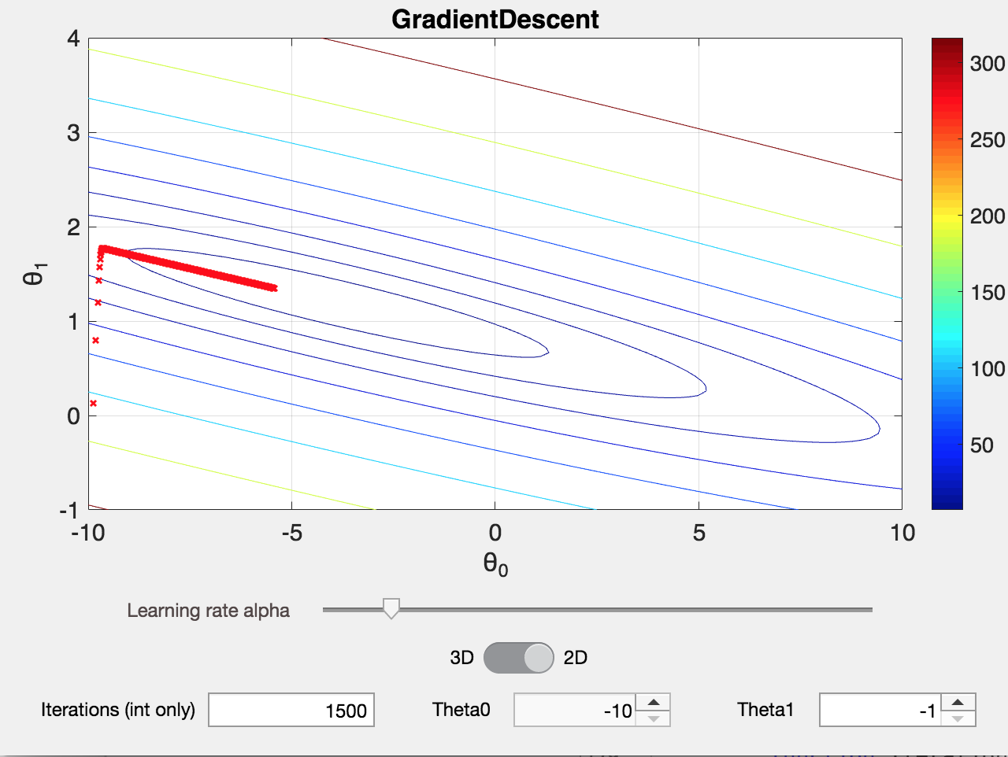
Animation Interface 1
Animation for gradient descent
Developed in MATLAB
More flexibility for students to change parameters
Iterations: number of loops running algorithm toward convergence
Learning rate: how fast each loop approach minimum cost function result
Theta 0,1: Starting theta values
Notes:
A little introduction of the parameters here: in order to be more interactive with students. theta 0 and 1 also means slope and intercept of a straight line, predict data set trend using straight line and how well it fits the data.

Slide 5
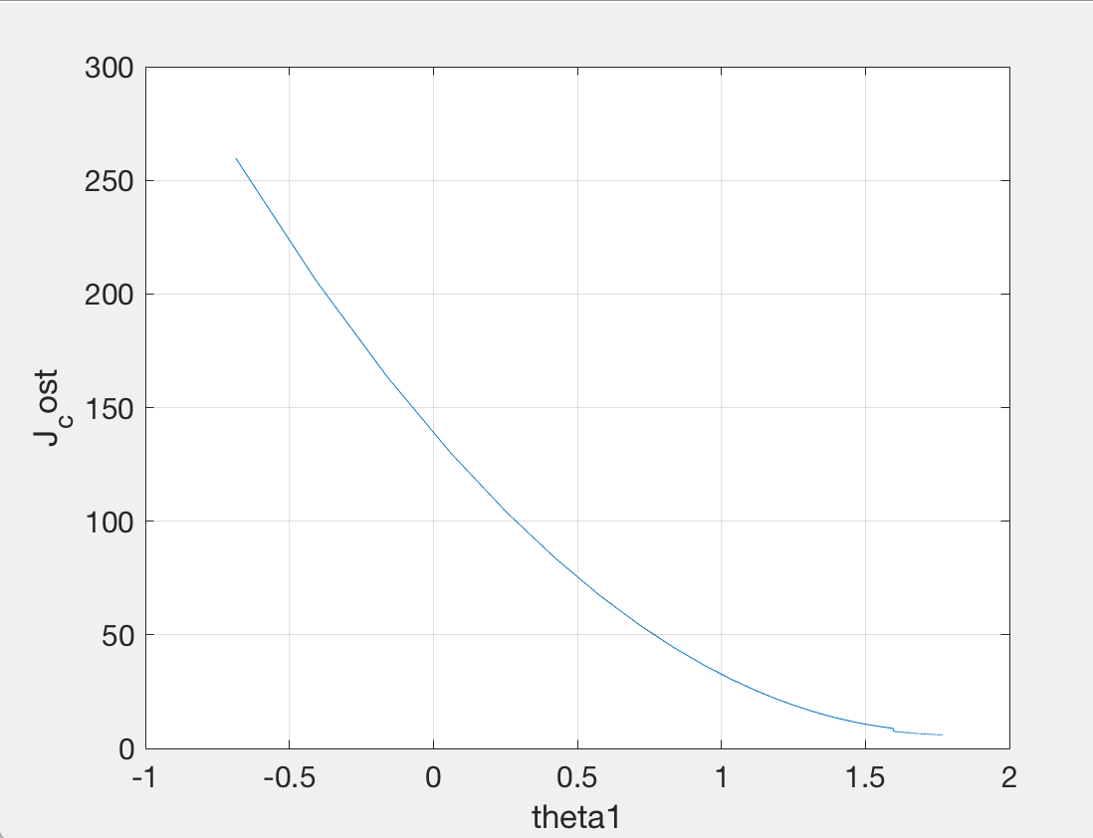
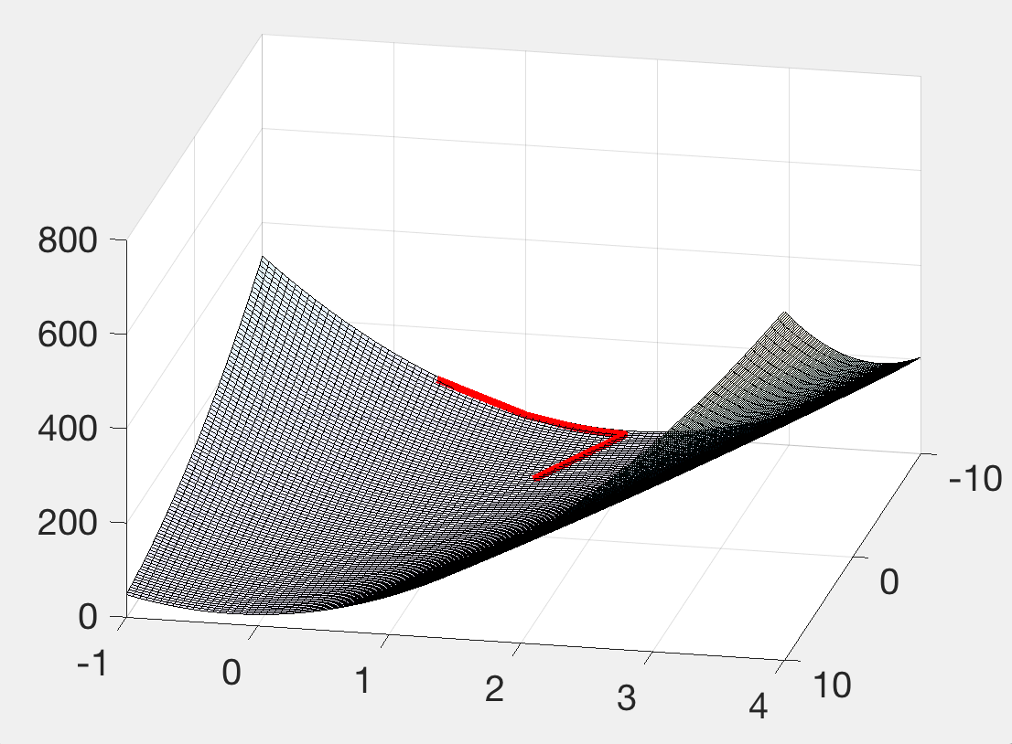
Intuitive Results in multiple ways
Notes:
So in these plot with the same dataset, you can see contour plot, 2D cost function and 3D theta values.

Slide 6
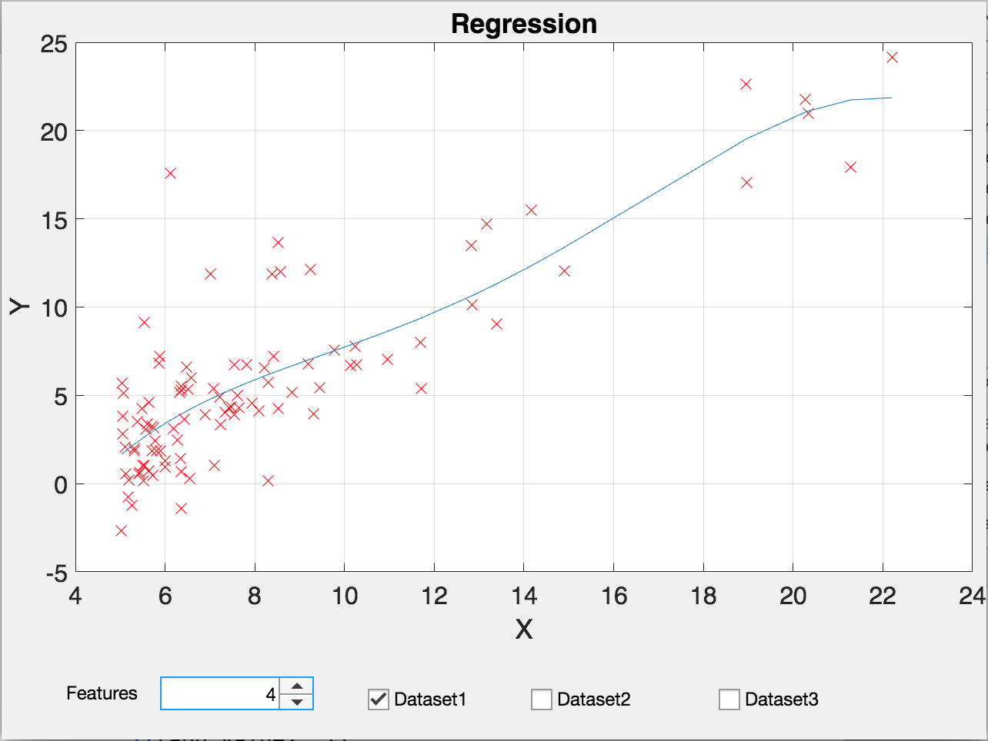
Animation Interface 2
Animation for linear regression
Feature number and dataset selection
Study how the number of features chosen fit data sets differently

Slide 7
Tensorflow - Third Animation (In progress)
Purpose: Predict Earthquake in an area using Neural Network
Using past data from USGS (United States Geological Survey)
Switching from MATLAB to python

Slide 8
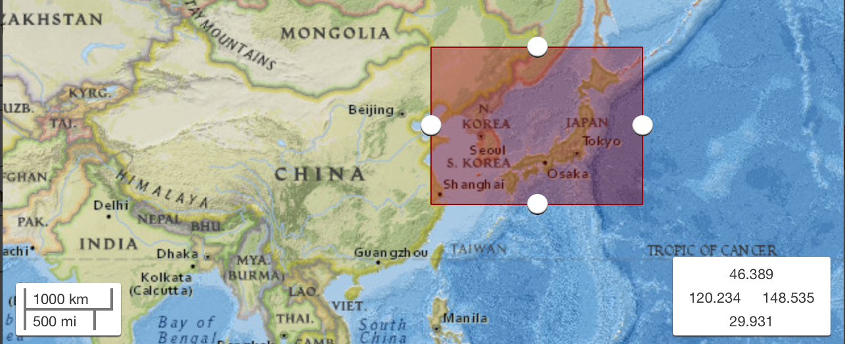
Tensorflow
Data selection (Real world data and processing)
Notes:
rectangular area contains earthquake data in the area from 2000 to 2008

Slide 9
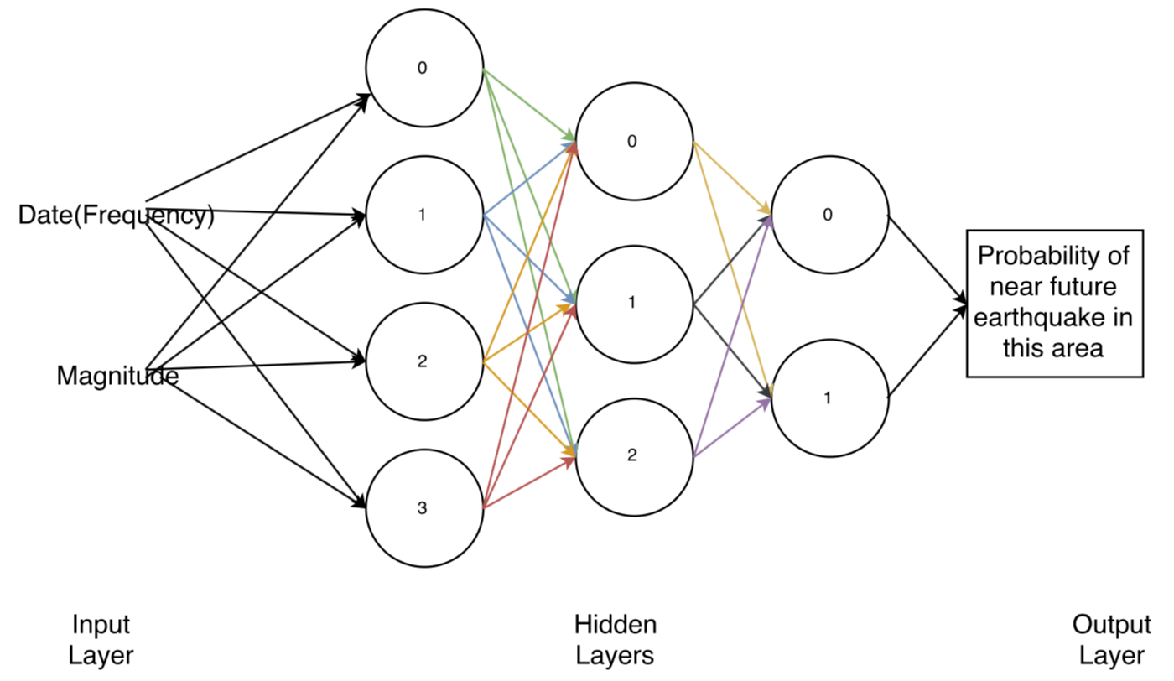
Tensorflow
Tensorflow Algorithm (Neural Network) Structure
Notes:
narrow down a neuron, recognize what category it belongs to, training the model, interact with it by inputting the time wanna predict, gives back possibility

Slide 10
Conclusions
Progress made based on our good goal:
Introducing students machine learning with animations
Give students opportunity to interact with tools while learning
Help students get big picture with less math and coding involved.
The workshop will have a test run soon
The project will continue next year, it will be further improved.
Notes:
Getting big picture is something often ignored for engineering students

Slide 11
Acknowledgements
Thanks to contributions by my supervisor Arielle Blum.
Reference:
Machine Learning by Andrew Ng from Stanford University on Coursera
Google API
MATLAB
Tensorflow

